Slide 1
Planning and Preparing for the Erigone-Regulus Great Occultation (ERGO) of March, 2014
Ted Blank
IOTA Annual Meeting
July, 2014 – College Park, MD
tedblank@gmail.com

Slide 2
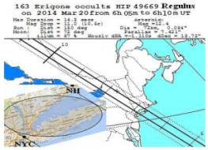
Background
In Nov., 2013 C. Sigismondi* pointed out that the outreach campaign for this event should focus on three characteristics:
The rarity and beauty of the event
The importance of absolute timing of the event
The utility of relative timing of the event
Due to the combination of predicted path and naked-eye visibility of the target star, this occultation had the potential to be the most-observed in history.
Thus it was deemed worthy of an extraordinary effort combining the wider public, amateur observers, IOTA and other scientific organizations.
*Sigismondi, C. “2014 OCCULTATION OF REGULUS: OPPORTUNITIES & OUTREACH”. LARIM XIV

Slide 3
Goals:
Use every available conduit to contact as many people as possible in advance of the event
Make everyone in or near the path a stakeholder (potentially millions of people)
“Flood the market” with accurate information about the event to outweigh the inevitable inaccurate information that would surface
Use the opportunity to educate people about Astronomy, the Solar System, asteroids, occultations, the value of scientific measurements, IOTA and its missions and goals
Make it as easy as possible for everyone to participate and measure the event to their highest possible level of accuracy

Slide 4
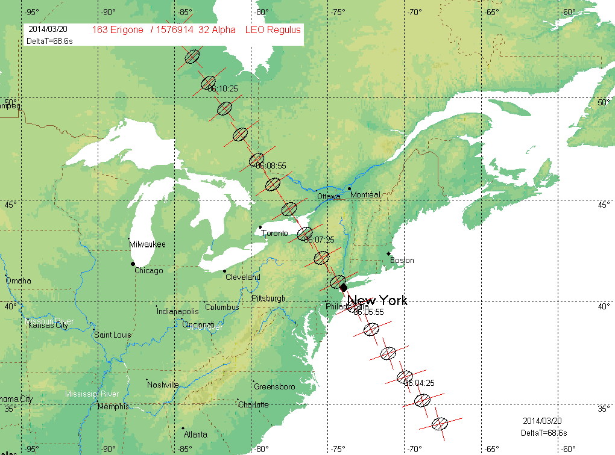
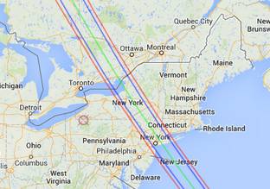
Early and Recent Predictions
First prediction of this occultation in 2004 by Prof. Aldo Vitagliano (University of Naples, Italy) via his SOLEX software package
Steve Preston communicated with Dr. Vitagliano about their various techniques and provided updated predictions throughout 1Q14

Slide 5
Challenges:
In January, 2014 I submitted an article to JOA entitled “Recruiting and Deploying a High-Density Public Observing Network for the 2014 Occultation of Regulus by (163) Erigone”
In the article I described the following challenges:
Informing the public of the event
Explaining its background
Providing training so inexperienced observers can obtain useful timing data with the best resolution possible
Disseminating real-time weather updates in the days leading up to the event
Managing the collection of large numbers of observations at greatly varying levels of accuracy
Notes:
Of course at the time I had no idea how to meet these challenges!

Slide 6
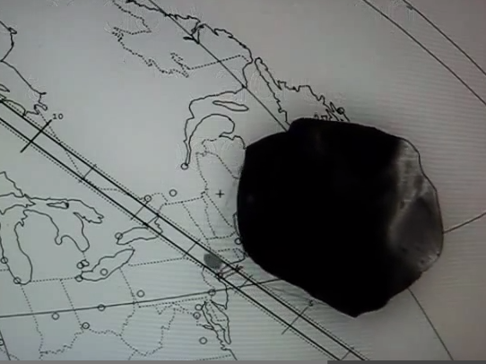
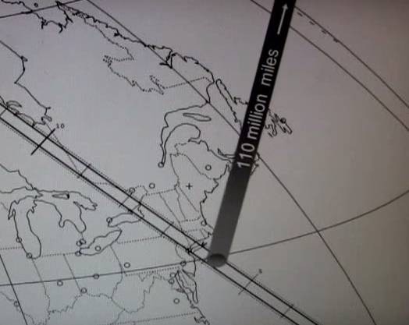
3Q 2013 – Nugent Video
Richard Nugent creates a YouTube video animation of the event. It gets over 6000 views.
Version 1
“Big Rock” version
Version 2 – shadow version
Thank you Richard!

Slide 7
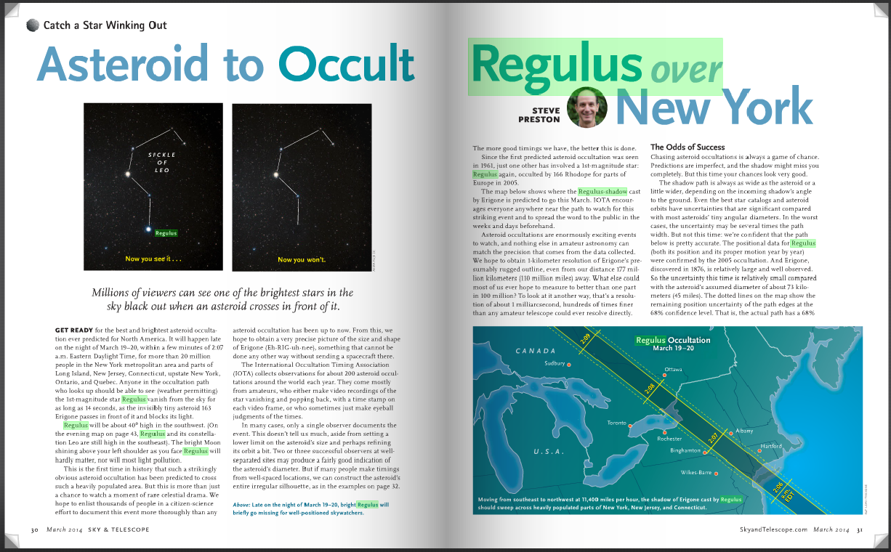
Late 2013 – Sky & Tel Article
Steve Preston authors a Sky & Telescope article for the March, 2014 issue

Slide 8
December, 2013 – Web Site & FAQ
Steve Preston starts a new Wordpress-based version of occultations.org
I begin work on the REGULUS2014 tab and Frequently-Asked-Questions section. Eventually it becomes a list of 32 questions with over 6000 words of answers.
About the Event:
What will happen on March 20, 2014 around 2:06 am EDT, and why is it so special?
At what time should I begin watching or recording the star Regulus?
If I go out, how can I be sure I’m looking at the right star (Regulus)?
What is an Occultation?
Is this Asteroid going to come anywhere near Earth?
Can Science Teachers use this event to help teach STEM (Science, Technology, Engineering and Math)?
What is IOTA?
What is an Asteroid?
Will we learn anything about the star Regulus from this event?
Where can I look for more details?
Observing and Timing the Event:
How can I best time the event?
How do I report my observation?
How will I know IOTA has received my observation?
Will IOTA share its results with me?
What is the best source of time to set my watch accurately?
Have there been other public campaigns to observe occultations of stars by asteroids?
Watching the Event:
From where can this event be seen?
Will I need special equipment to see the star?
How will I know if I can see this event?
What if I live far from the predicted path?
Is there someplace I can go to be certain I will see the event?
Why should observers spread out instead of placing themselves just along the predicted center line?
For how long a time will the star disappear?
Where should I go along the path for the best chance of clear weather?
What if I’m an amateur astronomer with no previous occultation timing experience?
IOTA (International Occultation Timing Association):
How can I join IOTA?
How can I donate to IOTA?
How does a Video Time Inserter work ?

Slide 9
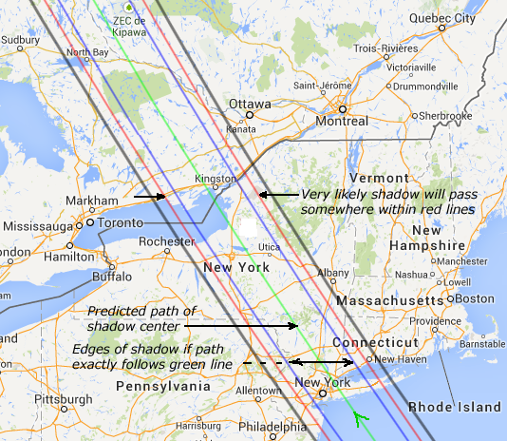
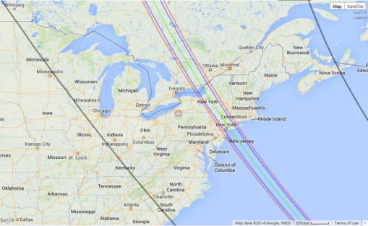
Website: Where Can I Go To See It?
Area in which it was more
likely that satellites of
Erigone might be observed
Annotated path map showing 1- and 2-sigma uncertainty limits
Notes:
We eventually added lines outlining the areas in which people who did not want to travel might observe looking for satellites of Erigone. These went roughly from New Hampshire to Pittsburgh, Pa. We included links to the prediction page, interactive Google maps, etc.

Slide 10
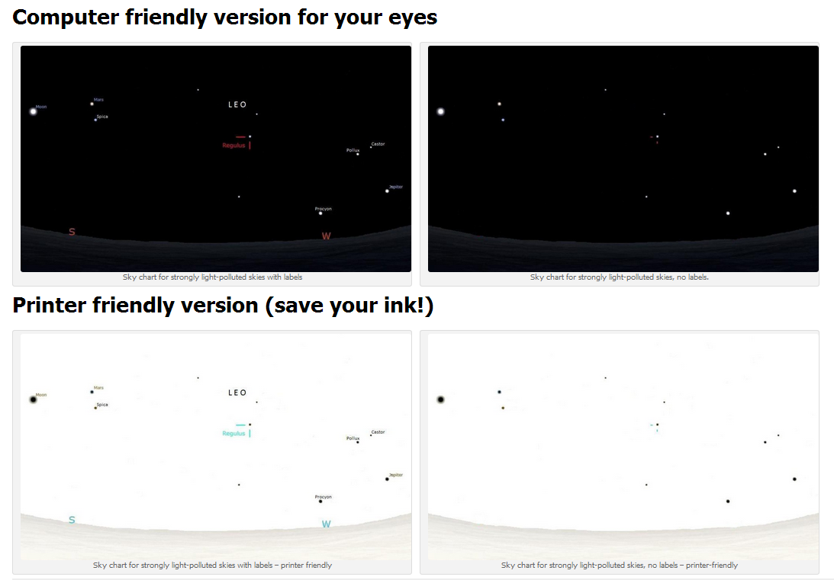
Website: How to Find the Correct Star
Sky Charts for Strongly Light-polluted City Environments
David Dunham provided maps to help find Regulus under various levels of light pollution.
We added these to the ERGO website.

Slide 11
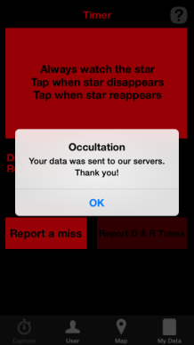
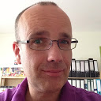
Website: How to Time The Event
We tried to cover every possible way even an inexperienced person could time the event (either absolute or relative)
Audio
Stop watch
DSLR video (Tony George)
Video with VTI
Drift recording
Dedicated Occultation App
Timing apps (Time The Sat, Emerald Timestamp)
John Talbot created a macro to read the data from the iPhone app and convert it to a form usable to IOTA
Norbert Schmidt, Occ. App
Developer
www.ddq.nl

Slide 12
What Can You Learn From A Million Observers Without Stopwatches?
We stressed the importance of simply reporting either:
“Yes, I saw the star wink out” or
“No, I did not see the star wink out.”
With a large number of observers, the closest “Miss” report is likely to be very close to a Positive report
This provides the opportunity to define the cross-path diameter with a high level of confidence
The Occultation App and Public Reporting Websites were both designed to make it easy to report a “Miss”

Slide 13
December, 2013 Contact Astro Clubs in/near Path
We contact as many astronomy clubs as we can find in or near the path and begin to develop a mailing list to keep them in the loop.
Amateur Astronomers Association of NY (NYC)
Amateur Observers Society of NY (Long Island)
NY Skies
Little Bear Observatory, Putnam, NY
Central New York Observers
FM Astronomy Society, Fayetteville, NY
Rockland Astronomy Club
Mid-Hudson Astronomical Association
Kopernik Astronomy Club, Binghamton, NY
Syracuse Astronomy Society
Syracuse Observers
Royal Astronomical Society of Canada

Slide 14
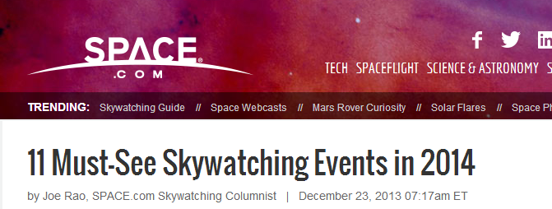
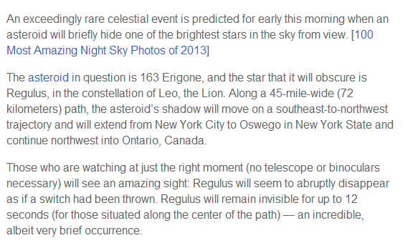
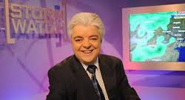
December, 2013 – Joe Rao of space.com lists ERGO #1 for 2014

Slide 15
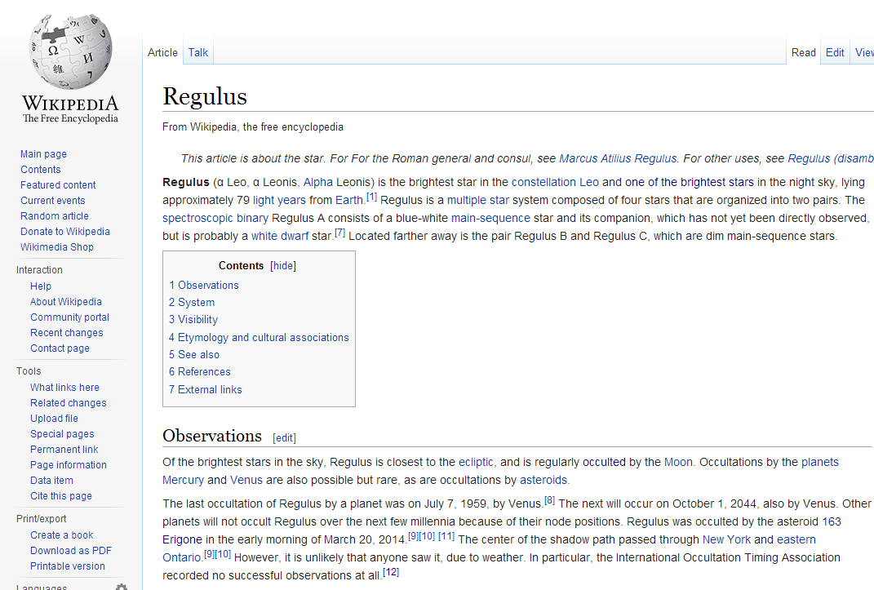
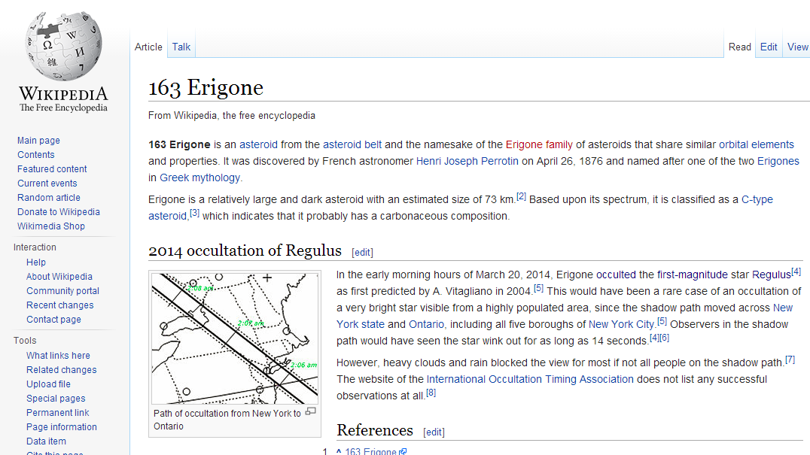
January, 2014 Update Wikipedia Pages
Updated Wikipedia pages for Regulus and Erigone to reference the occultation and IOTA web page

Slide 16
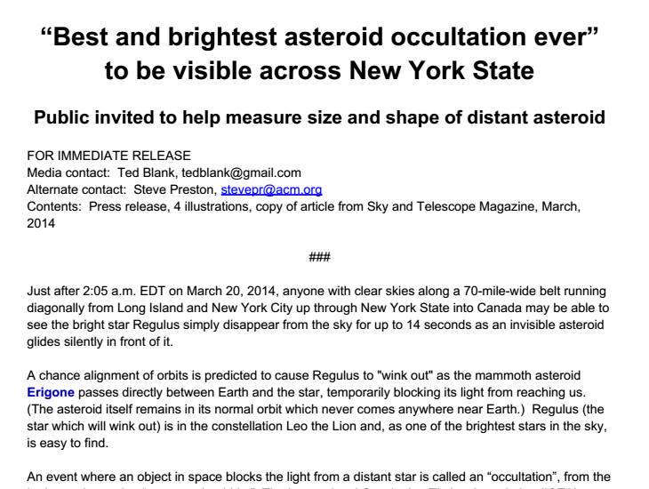
February, 2014 – Press Release
Press release prepared and sent to all contacts for general release

Slide 17
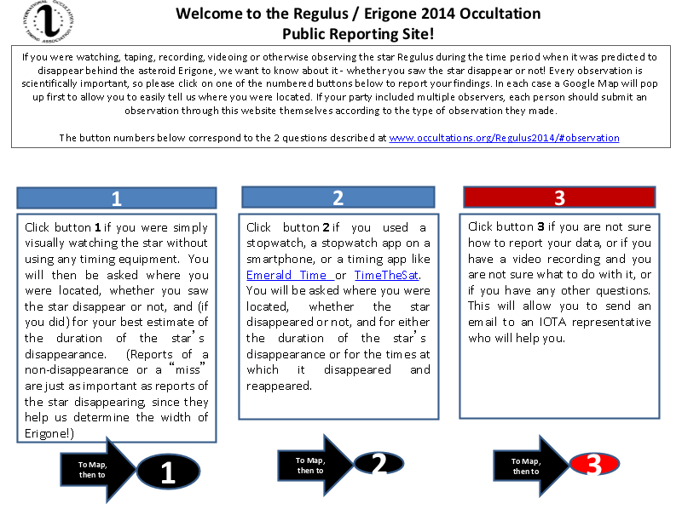
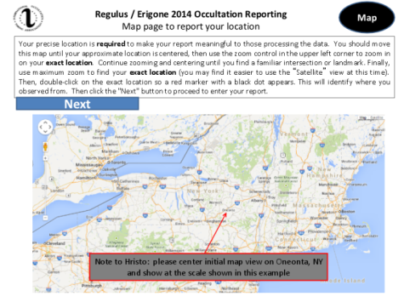
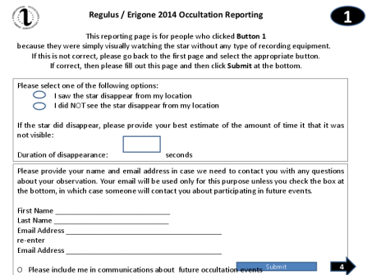
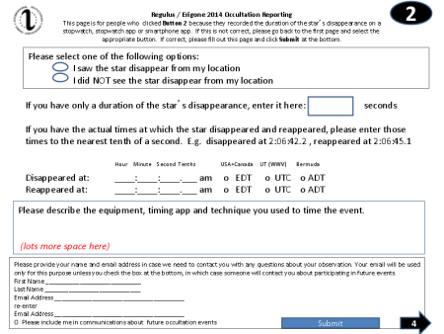
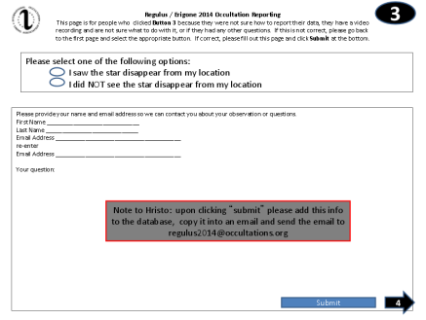
January-February, 2014 Public Reporting Site Design & Development By Hristo Pavlov in support of ERGO event

Slide 18
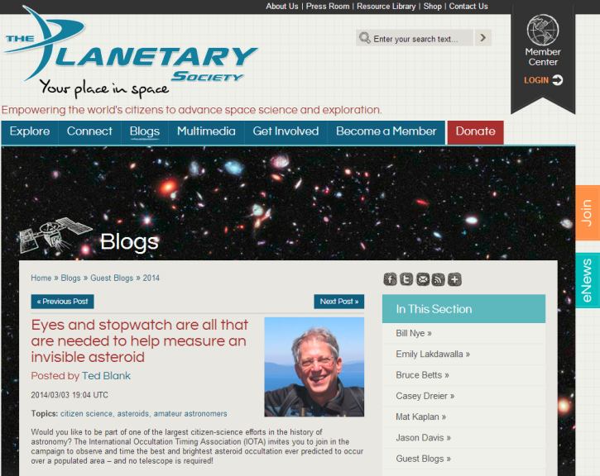
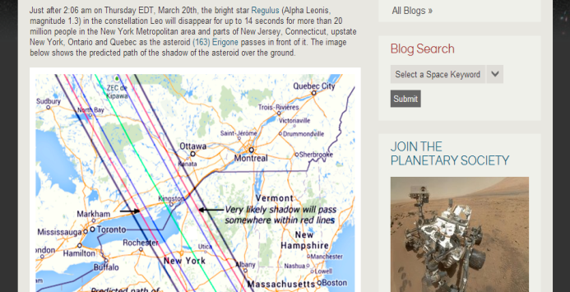
February, 2014 – Planetary Society
I receive permission from Planetary Society senior writer Emily Lakdawalla to author a guest entry in her blog on the Regulus occultation.
It goes live on March 3, 2014 on the Planetary Society website.
http://www.planetary.org/blogs/guest-blogs/2014/0301-invisible-asteroid.html

Slide 19
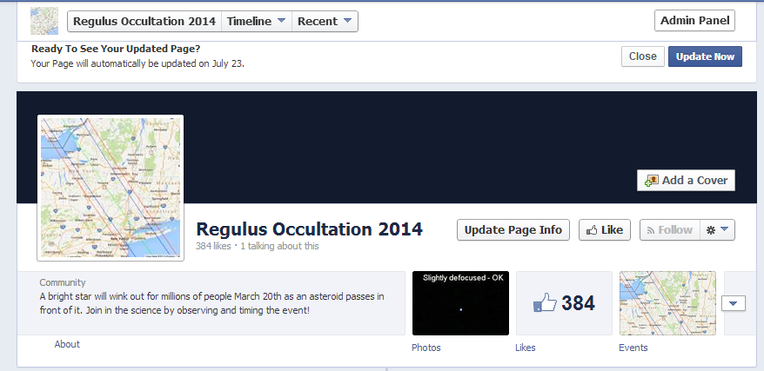
February, 2014 – Social Media
We go “Social” with Facebook page and Facebook Event
and receive 384 “Likes” by the time of the event

Slide 20
February / March, 2014 – Club Visits
I visit and give presentations to several Astronomy clubs in the occultation path, encouraging their participation and inviting them to involve the public
2/21 - Rockland Astronomy Club (with students from Rockland Community College)
2/22 - NY Skies (Manhattan)
2/23 - Amateur Astronomy Society of New York (Long Island)
3/11 – Amateur Astronomy Association of Princeton (NJ)
3/18 - Mid-Hudson Astronomy Association (New Paltz)
Very effective since each club has relationships they can leverage with local media outlets

Slide 21
February / March, 2014 Articles and Interviews
Sky & Tel – Alan MacRobert – Steve Preston
USA Today – Traci Watson – Steve Preston
Newsday in New York (Susan Rose, President of AOSNY)
USA Today story quoting Alan MacRobert of Sky & Tel
Astronomy.fm (online radio show) : Steve Preston did a one hour “live” interview the night of the event. They would welcome contact regarding future events.
Scientific American
SLOOH online telescopes – broadcast live images of Erigone and Regulus for several hours on the night of the event with Bob Berman. Ted Blank called in live around 2:15am to report being clouded out in New Jersey
WNYC Fox 5 – New York – Ted Blank interviewed in Sea Bright, NJ on March 20 during setup

Slide 22
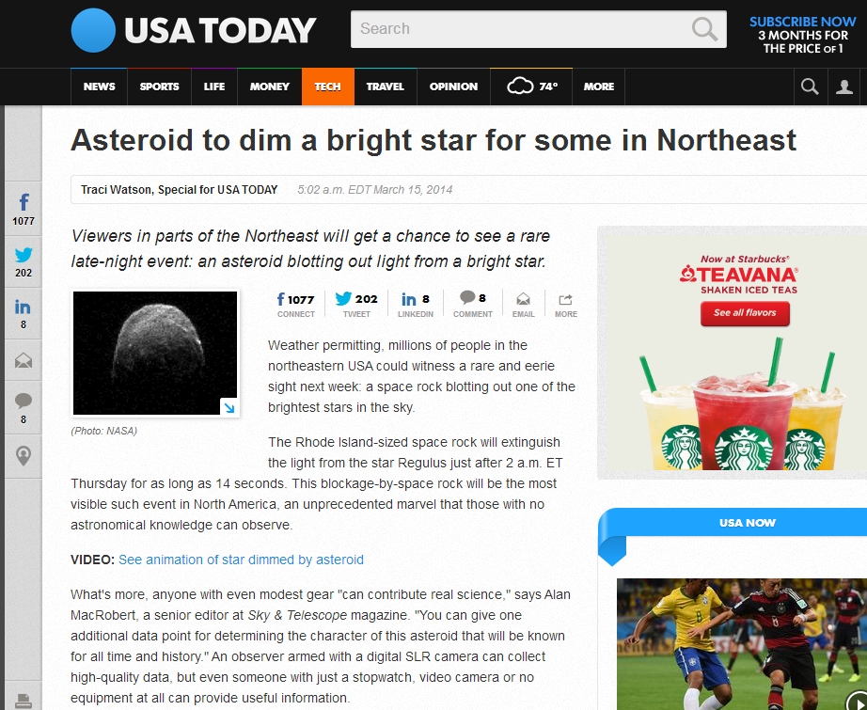
USA Today Article: Widely read, shared, tweeted

Slide 23
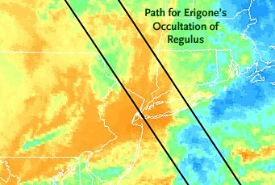
March 20, 2014 The Weather Does Not Cooperate ☹
Joe Rao, New York TV weather forecaster and Astronomy / Eclipse enthusiast, begins offering us detailed weather projections for the event
The centerline of the predicted path went right over Joe’s home town. He informs us that when he saw this back in 2013, he knew immediately the event would be clouded out.
Sadly, he was right.

Slide 24
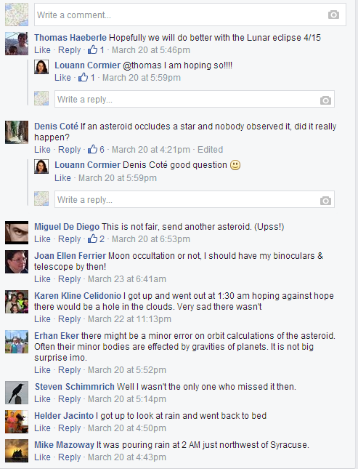
March 20, 2014 Facebook Page Comments Reflect General Disappointment With the Weather

Slide 25
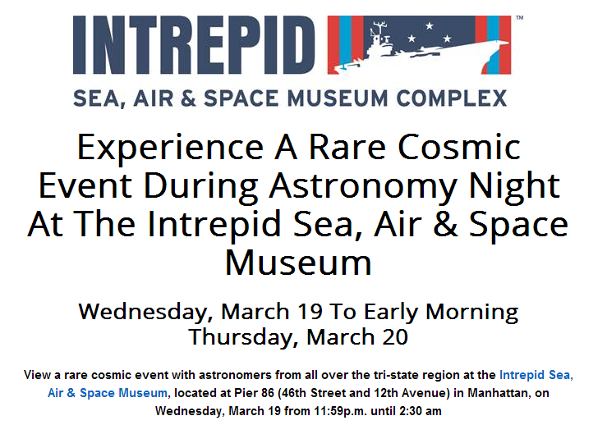
Some Tried To See The Occultation From the Aircraft Carrier Intrepid in NYC
The Amateur Astronomy
Association of NY holds a live public outreach event at the Intrepid Sea, Air and Space Museum in Manhattan

Slide 26
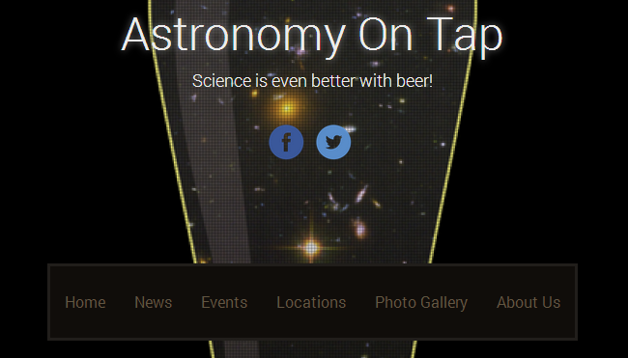
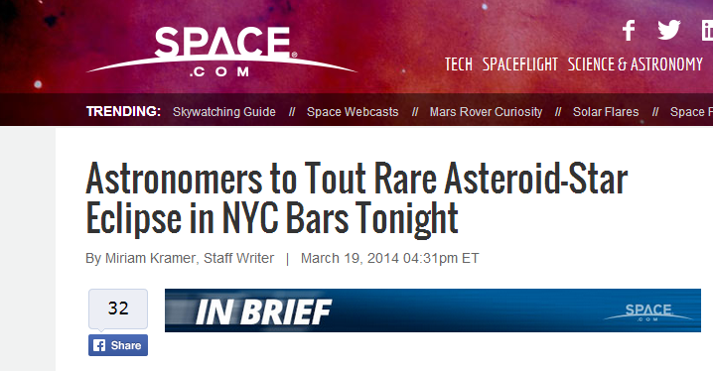
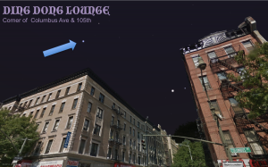
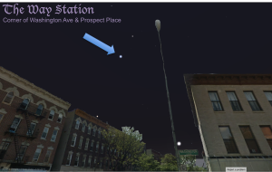
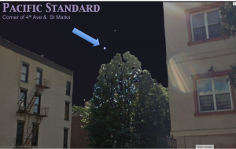
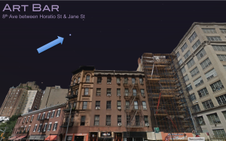
Professional Astronomers Plan To Observe From Bars in NYC
“Astronomy on Tap” prepares to time the event from several bars around Manhattan
#STARWINK

Slide 27
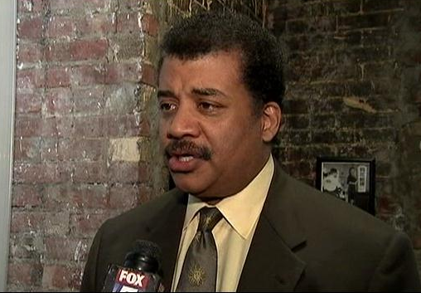
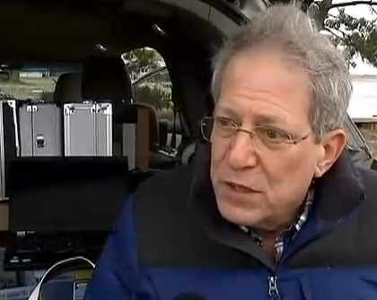
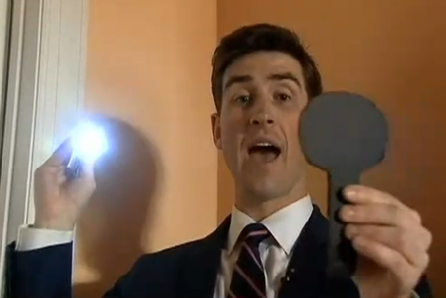
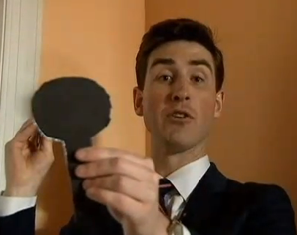
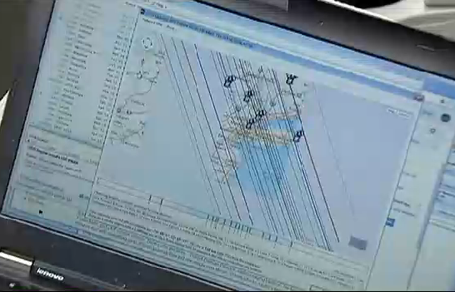
Fox News Channel 5 Mobile Van Followed Me To Seabright, NJ For Interview
I am interviewed by reporter Mac King of NYC Fox News 5 in Seabright, NJ as I set up for the faint possibility that skies will clear in time for the occultation. (That other guy was just interviewed for background…)
Back in the studio reporter Mac King demonstrates an occultation and gets it right! (I gave him the cardboard asteroid!)
http://www.myfoxny.com/story/25021797/neil-degrasse-tyson-explains-occultation-of-regulus

Slide 28
Kudos to Those Who Travelled From (or To) Afar
Eberhard Bredner and Konrad Guhl from Germany to New York
David Dunham, Hal and Katie Povenmire to Bermuda (one confirmed miss – the only reported observation)
Akie Hashimoto from Japan to New York
(Google translation from his report to the Japanese Occultation Information Network):
“It becomes the 20th, the sound of rain, so no longer from the past 01h, I tried to get out, but occasionally. You can not see the moon stars that should have come up with, let alone drizzle.”
Terry Redding, Aart Olson and Steve Messner also recorded Regulus and reported misses, but from well outside the predicted path (and away from the clouds)

Slide 29
Lessons Learned
Use all possible avenues of communication. More like “chumming” than “fishing”.
Mass media is a “now” phenomenon – tough to get their attention until last minute
Facebook was surprisingly effective, both page and “event”. Easy for people to share with friends.
Personal visits to astronomy clubs in the path were effective due to their extensive local contacts – multiplier effect.
We should have asked the public to register their interest so we could continue to contact them after the event (email list)
Need to make clearer the distinction between “miss” and “could not observe / no observation”
Occultation App and Public Reporting Site are good start but both need work

Slide 30
Lasting Benefits
Wide media coverage – easier next time?
Increased public exposure / awareness of:
Astronomy
Solar System Science
Asteroids
Occultations
Increase in traffic to IOTA webpages
New observers for occultations
“Version 1” of Occultation App and Public Reporting Website are now available for improvement

Slide 31
Links to Articles and Sites
http://www.newscientist.com/article/dn25251-new-york-asteroid-eclipse-will-be-visible-to-millions.html#.Uy3CofldWSo
http://www.planetary.org/blogs/guest-blogs/2014/0301-invisible-asteroid.html
www.facebook.com/Regulus2014
www.occultations.org/Regulus2014
www.occultations.org/Regulus2014/R14DSLR
http://www.usatoday.com/story/tech/2014/03/15/asteroid-star-northeast/6417135/
http://www.myfoxny.com/story/25021797/neil-degrasse-tyson-explains-occultation-of-regulus

Slide 32
Thanks To All Who Made Major Contributions Along The Way
Hristo Pavlov
Tony George
Steve Preston
Brad Timerson
John Talbot
David Dunham
Sue Rose, AOSNY
Damian Allis, SAS
John Pazmino, NY Skies
Keith Murdock, RAC
Roger Venable
Richard Nugent
Joe Rao
Larry Gerstman
And many others…

Slide 33
Thank You!! Clearer Skies Next Time!

